Slide 1


The Battle of Neighborhoods: Toronto vs. New York
Applied Data science with python
Farzin Maniei

Slide 2
1. Introduction
Background: One of the important questions for business ventures willing to open a new location is “What are the good potential site locations for a new store to maximize their sales?”
To answer this question, the first step is to layout a good demographic of current business ventures in the neighborhood of the interest. This would provide information about top current venues, their locations, the competitors business, population preferences, etc.
Problem: As described in the background, the problem is to find potential site locations for a new venue in a neighborhood. This project investigates the potential site locations and business ventures in a neighborhood of Toronto, Canada. Then, the same exercise will be performed for the city of New York, U.S.A.
Interest: This is a very interesting topic for entrepreneurs and business owners who are interested to start or expand their business in a neighborhood. The result of this project will be beneficial to layout a business development plan.

Slide 3
2. Data Acquisition and Cleaning
Data Sources: The postal code of Canada are extracted from a Wikipedia page https://en.wikipedia.org/wiki/List_of_postal_codes_of_Canada:_M and stored in a csv file as a table. The data for New York City is obtained from a dataset provided in https://cocl.us/new_york_dataset.
Data Cleaning: After creating the datasets, the datasets need to be cleaned and wrangled to exclude the invalid or incomplete datapoints.

Slide 4
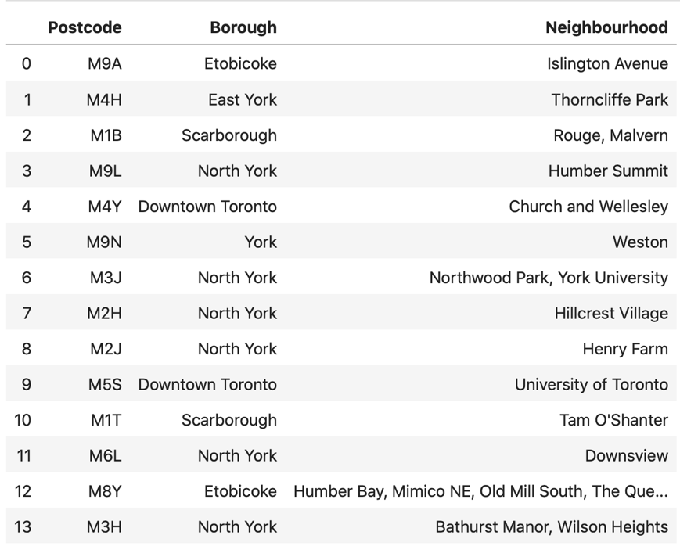
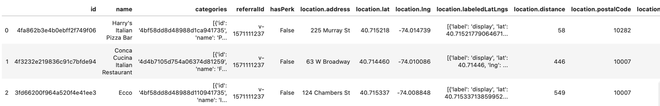
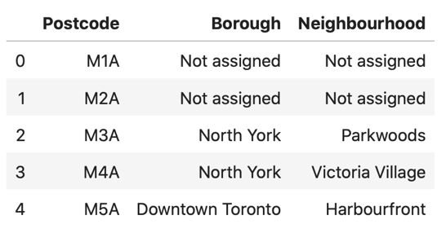
3. Exploratory Data Analysis
Data Explanation: The dataset for the city of Toronto includes Postcodes, Borough, and Neighborhood. The Postcode in the dataset is all the postcodes in the city of the Toronto that starts with M. The following figure shows a part time of the dataset as a table:
Data Preparation: In this step, dataset will be prepared for data analysis.
Figure 2. City of New York’s Neighborhood
Figure 3. City of Toronto Dataset (Sorted).
Figure 1. City of Toronto’s Neighborhood
(Postcode starting with ‘M’)

Slide 5
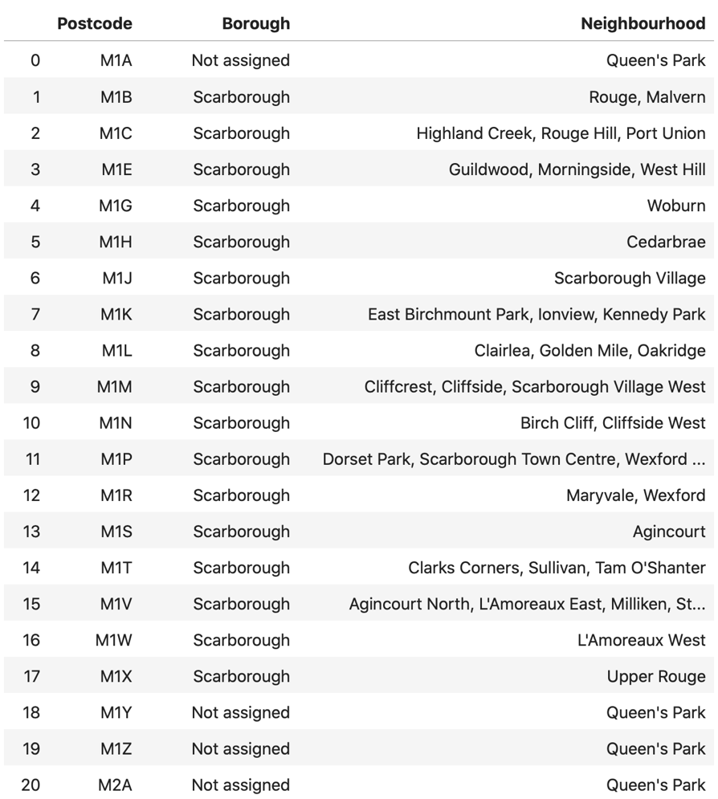
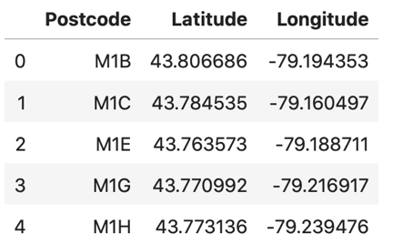
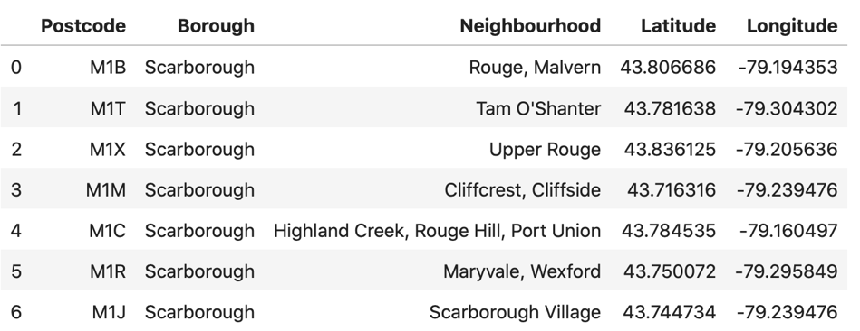
3. Exploratory Data Analysis (cont.)
Figure 5. City of Toronto – Geospatial Data for the Postcodes.
Figure 6. City of Toronto – Dataset combined with the Geospatial Data.
Figure 4. City of Toronto Dataset
(After Replacing unknown Neighborhood cells).
Figure 7. New York City Dataset.

Slide 6
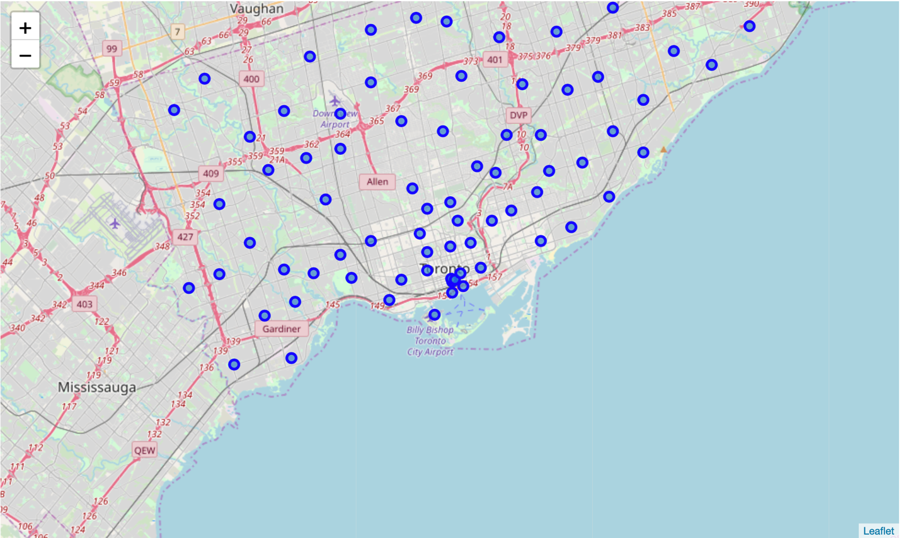
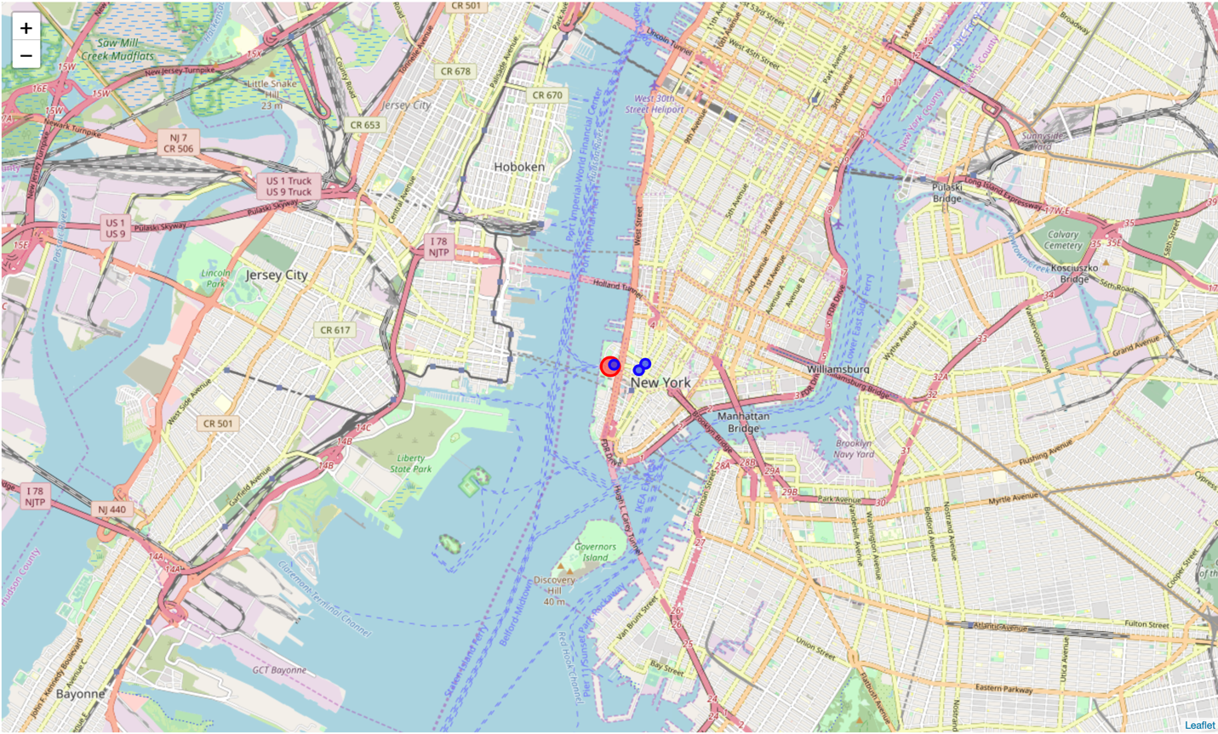
4. Exploring the Data
Data Visualization: Data Visualization is to represent data graphically. One of the interesting data visualization methods is map visualization which is used to graphically display data in the form of map. Dealing with the geospatial dataset, it is recommended to produce map visualization for better understanding the data. This helps to discover the potential stories that are hidden prior to map visualization (or data visualization). Using the ‘folium’ library in Python, the datasets for Toronto’s and New York City’s Neighborhoods can be represented on a map using northing and eating which provide the map visualization for the datasets.
Toronto’s and New York City’s datasets are represented on a map that shown in Figures 8 and 9, respectively.
Figure 8. Toronto’s Neighborhood Dataset – Map Visualization.
Figure 9. New York City’s Neighborhood Dataset – Map Visualization.

Slide 7
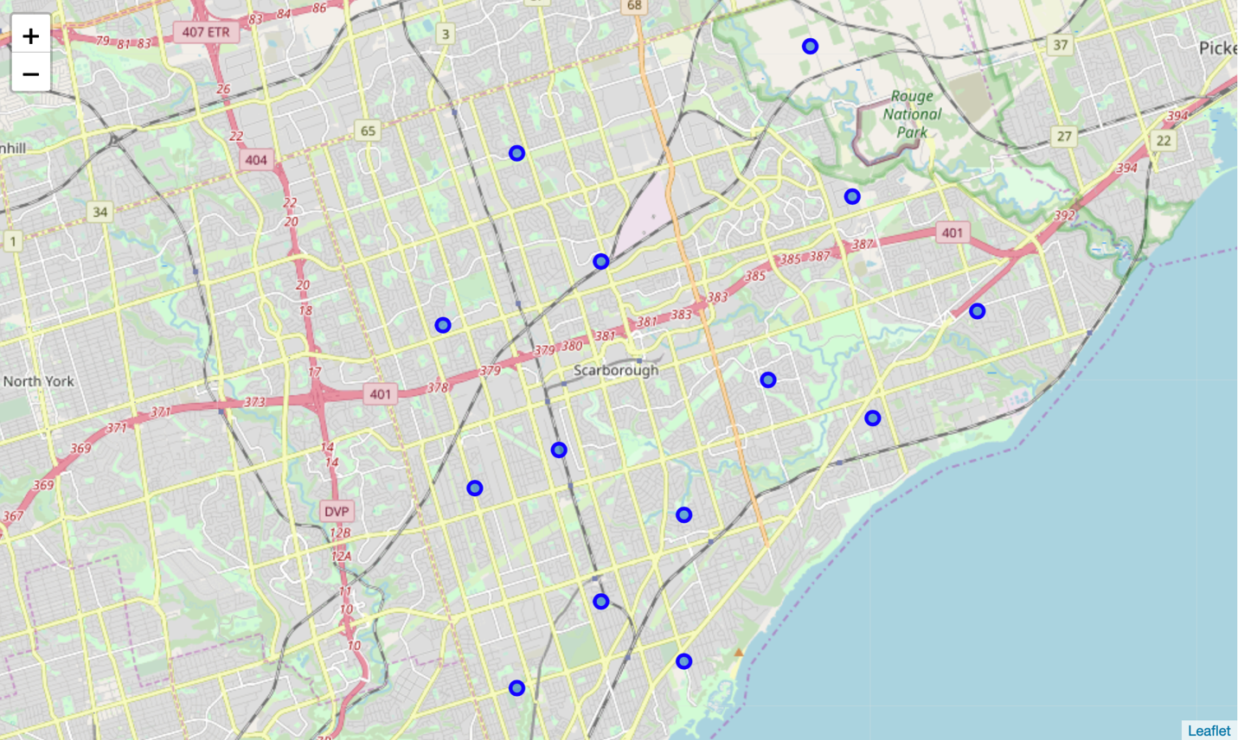
4. Exploring the Data (Cont.)
Identifying the Target in the Dataset: The dataset for Toronto’s neighborhood includes several neighborhoods. For this project, ’Scarborough’ neighborhood is selected as a target neighborhood from the dataset of Toronto’s Neighborhood. Then, the dataset is filtered by ‘Borough’ variable with value o ‘Scarborough’. Figure 10 shown this filtered dataset.
Figure 11. Toronto’s Neighborhood Sub-Dataset – Map Visualization.
Figure 10. Toronto’s Neighborhood Dataset – Filtered Dataset.

Slide 8
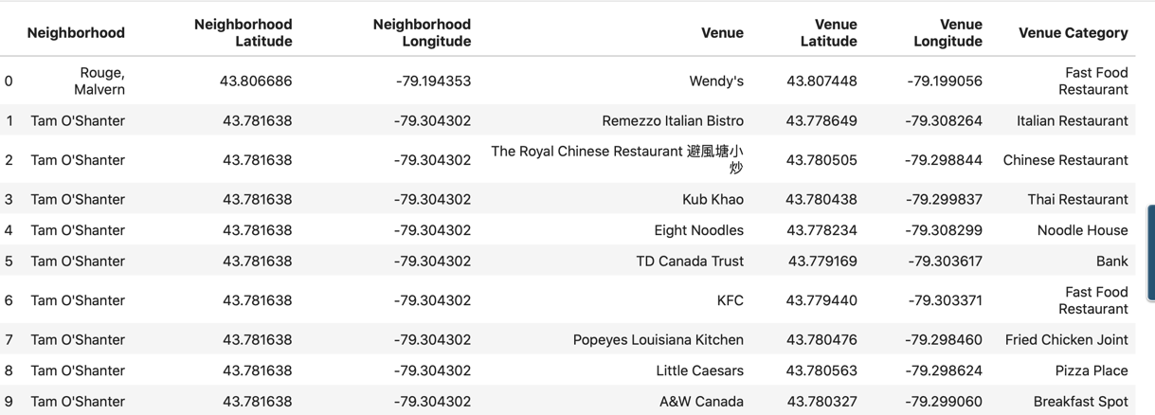
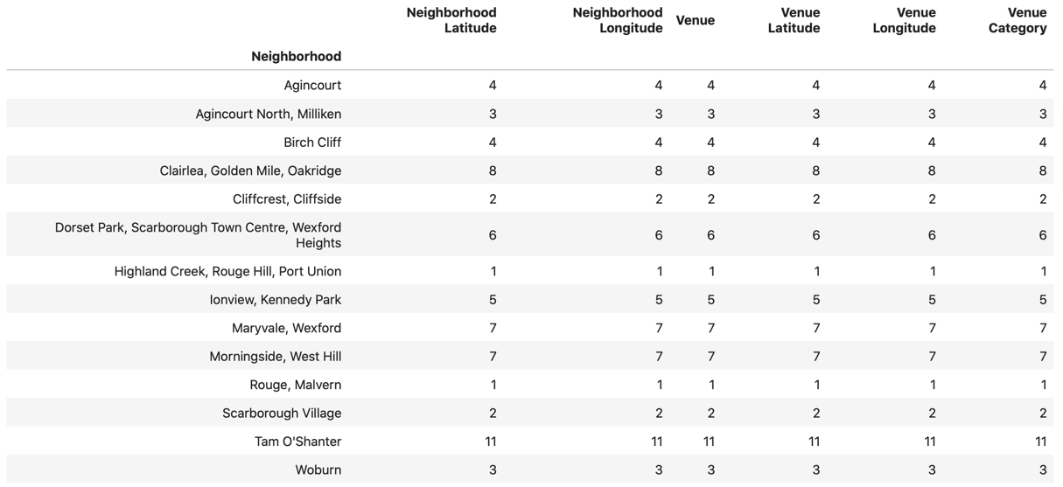
4. Exploring the Data (Cont.)
Problem Definition: As discussed in the background, this project is focused on exploring current venues in the neighborhoods of Toronto in Canada and New York City in U.S.A in order to find potential site locations for a profitable venue in the neighborhoods.
Identifying Current Venues in the Neighborhoods
Neighborhoods of Toronto: To understand the market, the sub-dataset for ‘Scarborough’ neighborhood of Toronto will be ordered by current venues. The following figure show the top nine venues in ‘Scarborough’ neighborhood:
The statistics of the current venues in Toronto’s neighborhood is provided in Figure 13.
Figure 12. Toronto’s Neighborhood Sub-Dataset – ‘Scarborough’ Neighborhood.
(Sub-dataset is ordered by venue, top nine venues)
Figure 13. Toronto’s Neighborhood – Statistics of the Current Venues.

Slide 9
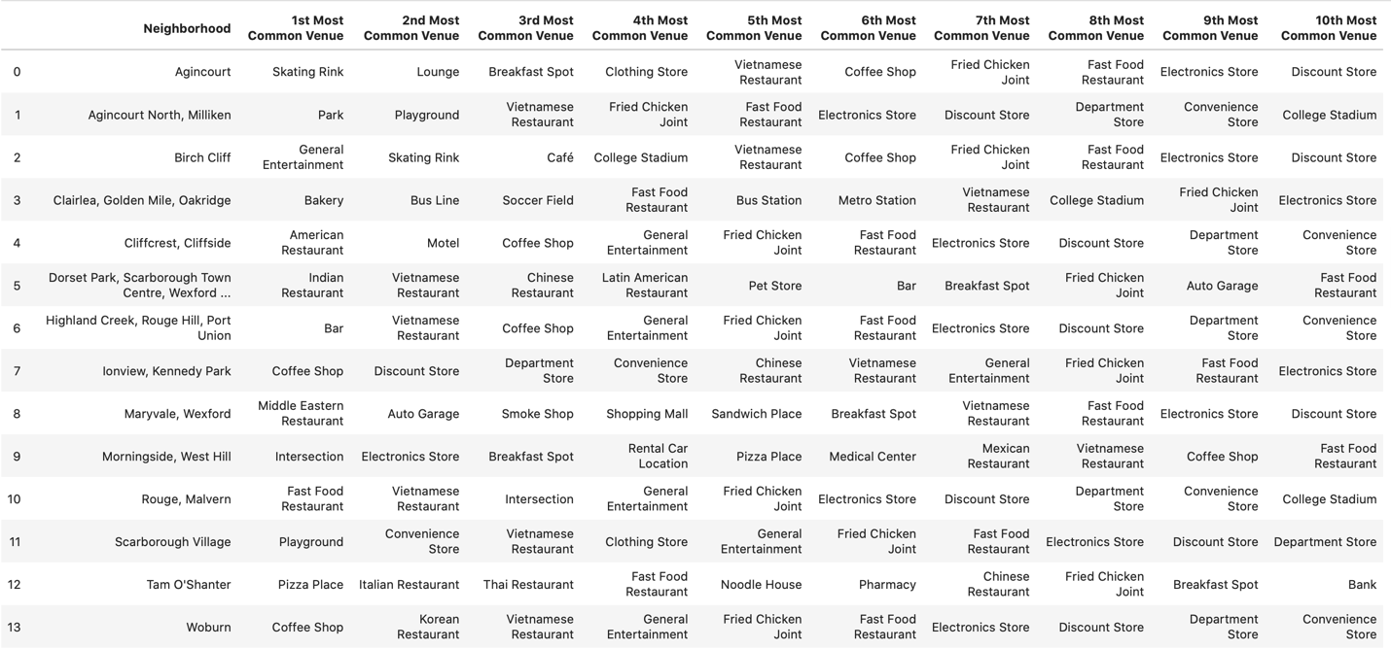
4. Exploring the Data (Cont.)
Now, it is important to find the top 10 most common venues for Toronto’s neighborhoods. Figure 14 provides the top 10 most common venues for Toronto’s neighborhoods. All the venues are clustered based on the type of venue. Figure 15 shows all the venues in Toronto’s neighborhood by type of venue. These clusters are represented as map visualization in Figure 16. By taking these steps, the dataset will be classified such that it reveals the top 10 most common venues in the target sub-dataset Scarborough neighborhood. This method is called ‘Data Classification’.
Figure 14. Toronto’s Neighborhood – Top 10 Most Common Venues.

Slide 10
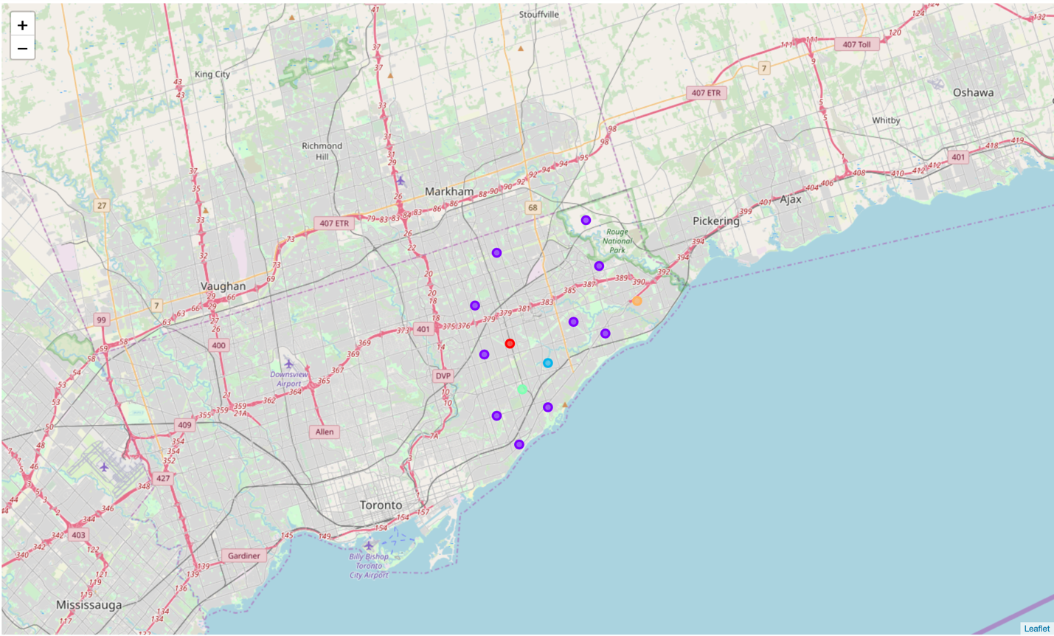
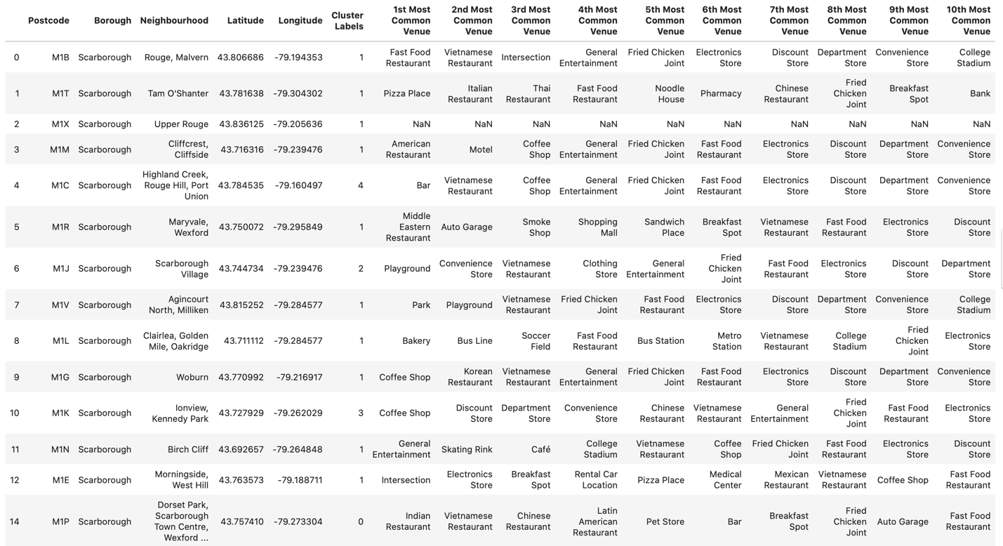
4. Exploring the Data (Cont.)
Figure 15. Toronto’s Neighborhood – Top 10 Most Common Venues (Clustered).
Figure 16. Toronto’s Neighborhood – Top 10 Most Common Venues (Clustered).

Slide 11

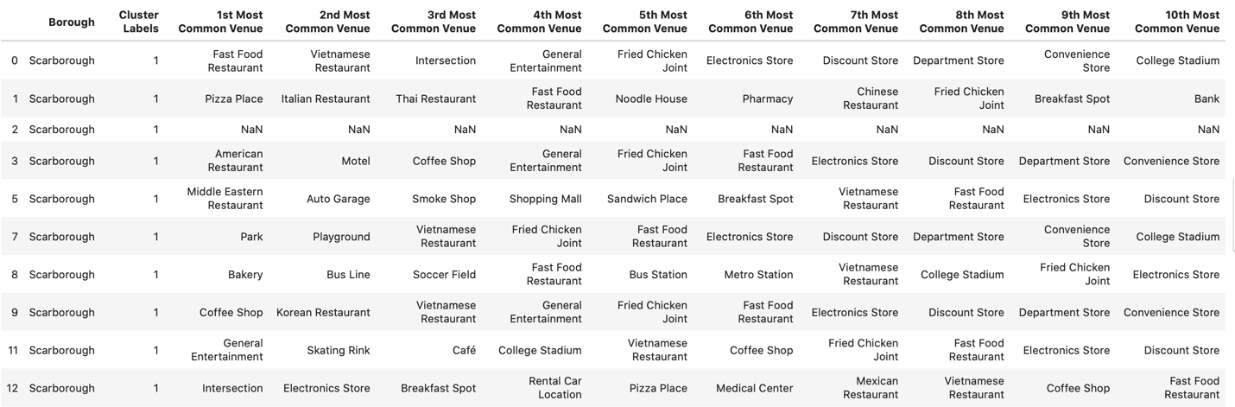
4. Exploring the Data (Cont.)
Figure 17. ‘Scarborough’ Neighborhood – Top 10 Most Common Venues in (Clustered).
Figure 18. ‘Scarborough’ Neighborhood – Top 10 MostCommon Venues in (Clustered).
(Different Cluster Labels)

Slide 12
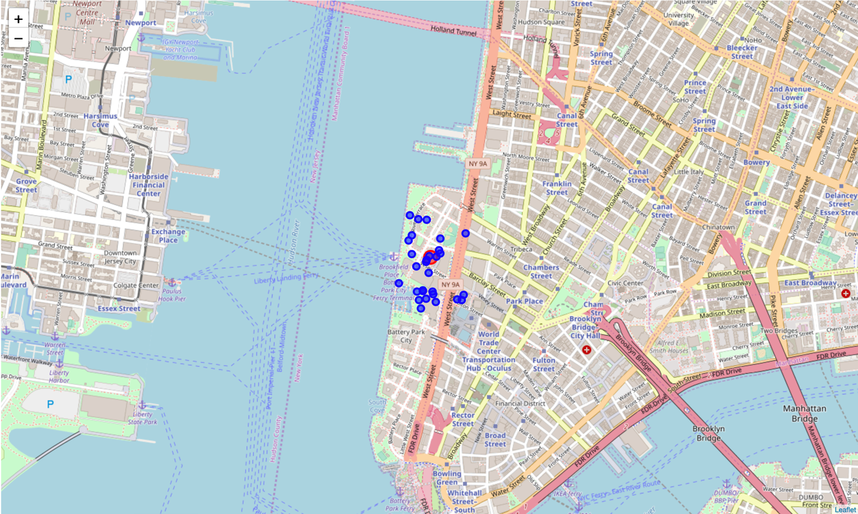
4. Exploring the Data (Cont.)
Neighborhoods of New York City: The same process has been followed for New York City’s neighborhoods and the following figure is obtained:
Figure 19. New York City Neighborhood – Most Common Venues in (Clustered).
(Map Visualization).

Slide 13
5. conclusion
According to the data exploration, if an investor is willing to open a new business in Scarborough neighborhood of Toronto, Canada then Vietnamese restaurants is the best most common restaurant in the neighborhood while the best most common restaurant in New York City neighborhoods is Italian restaurants.
6. Future development
This project can be extended by acquiring the census data for the target neighborhoods in Toronto and New York City. By including the census data, the current market can be explored for reaching better decisions with more details.

